Slide 1

Nestlé Customer Experience Analysis in 2020
Assumption:
This presentation is for upper management only. Certain technical information are missing, e.g. business units lookup table. Adjustment will be applied once missing information are provided.
Assume business unit lookup table below:
Agenda
Deep dive in Engage ticket system
Google Analytics at brand level
Rate & Ranking analytics at business and brand level
Sentiment analytics on Q&A
Key learnings
Business Unit | Business Unit Name
Business 1 | Ice Cream
Business 2 | Beverages
Business 3 | Coffee
Business 4 | Infant Nutrition
Business 5 | Confectionery-Sweets

Slide 2
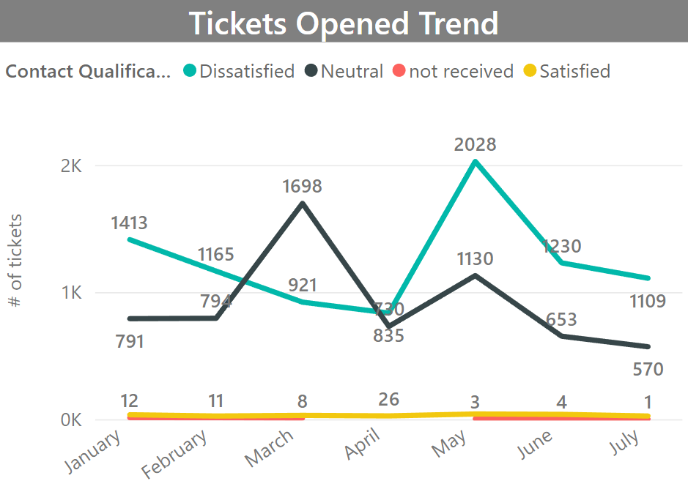
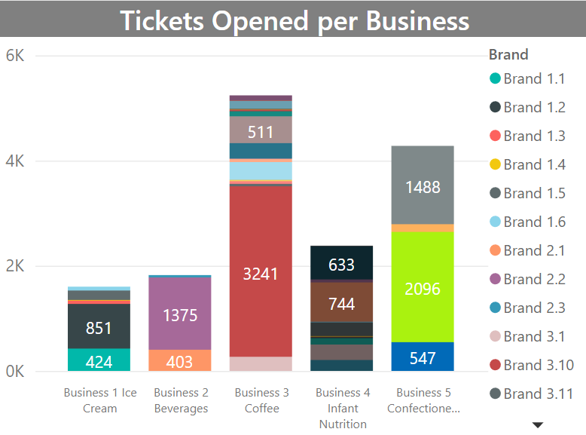
Tickets in Engage System
Brand 5.2
Brand 3.10
Customers are dissatisfied with their contact experience in six out of seven months between January and July 2020.
Satisfied rate is only 1.5%.
Most tickets are related to Business 3 Coffee (34%), especially Brand 3.10 (21%).
Following that is Business 5 Confectionery-sweets (28%) with Brand 5.2 (14%).

Slide 3
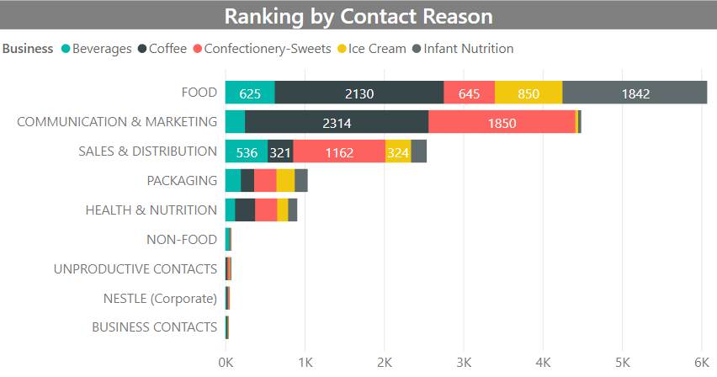
What is the main contact reason?
The main contact reason is related to Food (40%)
35% of food tickets mentioned Coffee and 30 % of food tickets is related to Infant Nutrition
Coffee
Infant Nutrition
The other two reasons are communication & Markets (30%) and Sales & Distribution (17%).
Overall, most customers complain Coffee’s Food & Communication & Marketing; Infant Nutrition’s Food; Confectionery-Sweets’ Communication & Marketing
Confectionery-Sweets
Next we deep dive into Food tickets for details.
Notes:
.
Following food tickets, customers also contacted us for Coffee’s Communication and Confectionery’s Sales & Distribution.
Next we deep dive into Food tickets for details.

Slide 4
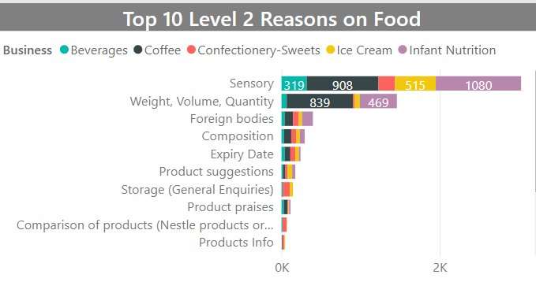
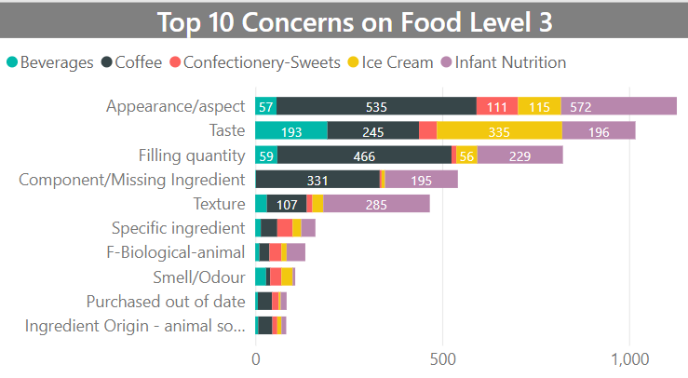
Deep Dive into Food Tickets
Since most of tickets are related to food (40%), here we’re deep diving in food tickets.
Sensory is top level 2 reason on food (49.77%), then is Weigh, Volume, Quantity (24%)
Appearance/aspect is top level 3 reason on food (23%), then is Taste (17%) and Filling quantity (14%)
Majority of Sensory tickets are for Infant Nutrition (18%) and Coffee (15%) .
Majority of Weight, Volume, Quality tickets are for Infant Nutrition (8%) and Coffee (14%)
Majority of Appearance/aspect tickets are for Infant Nutrition (9%) and Coffee (9%) .
Majority of Taste and Filling quality tickets are for Infant Nutrition and Coffee.
Next slide we deep dive into Level 4 reason on Food tickets for details.
Notes:
Customers are not satisfied with product appearance for Coffee (3.5%) , Infant Nutrition (3.7%).
1.4% of Customers notice there are ice crystals inside of Infant Nutrition products. This might cause potential health hazard for infants. It needs immediate attention from management.
There are many Coffee products missing wafer, 1.8% of customers mentioned that.
And the filling quantity and weight for coffee and infant nutrition are questioned by 5% of customers.
Moreover, 2.2% of customers complain Ice Cream and Beverage tasting different from expected.
If time allows, will deep dive into Communication and Sales.
Next we want to know which business has the most number of tickets
Coffee: appearance and filling quantity, missing wafer and no fresh
Confectionery: appearance, find lumps.
Infant nu: appearance, texture, filling quantity, ice crystals, melted
Ice cream: taste different
Beverage: taste different

Slide 5
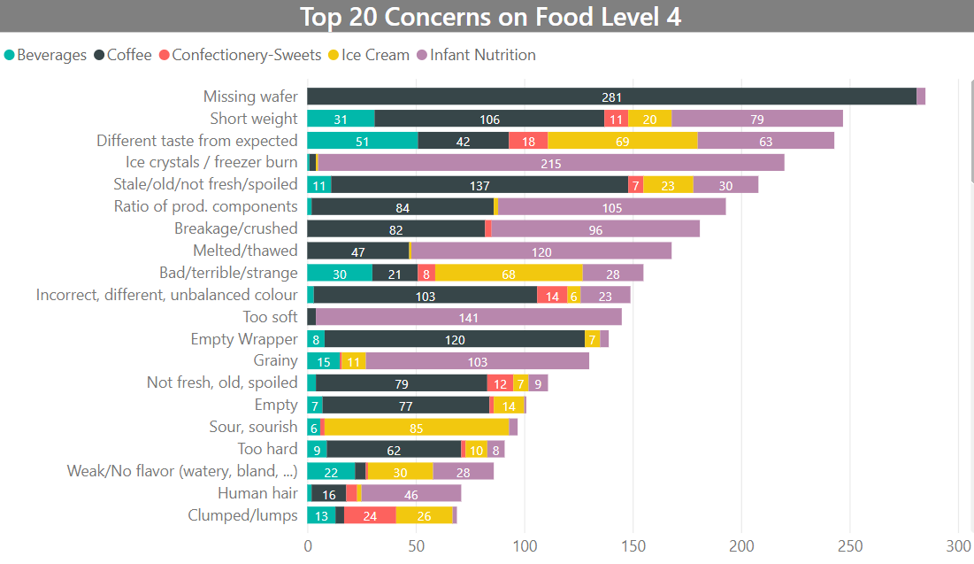
Deep Dive into Level 4 Reason on Food Tickets
There are many Coffee products missing wafer, 1.8% of customers mentioned that.
1.4% of Customers notice there are ice crystals inside of Infant Nutrition products. This might cause potential health hazard for infants.
All five business lines are complained on short weight, mainly coffee and infant nutrition.
Considering top reasons of all levels, Coffee and Infant Nutrition are mentioned the most often.
Most customers are not satisfied with Infant Nutrition’s appearance and texture, especially they found ice crystals inside our products and they notice the products are melted or too soft.
Relatively same amount of customers complain Coffee’s appearance, filling quantity, missing ingredient.
2.2% of customers complain Ice Cream and Beverage tasting different from expected.
Notes:
Customers are not satisfied with product appearance for Coffee (3.5%) , Infant Nutrition (3.7%).
1.4% of Customers notice there are ice crystals inside of Infant Nutrition products. This might cause potential health hazard for infants. It needs immediate attention from management.
And the filling quantity and weight for coffee and infant nutrition are questioned by 5% of customers.
Moreover, 2.2% of customers complain Ice Cream and Beverage tasting different from expected.
If time allows, will deep dive into Communication and Sales.
Next we want to know which business has the most number of tickets
Coffee: appearance and filling quantity, missing wafer and no fresh
Confectionery: appearance, find lumps.
Infant nu: appearance, texture, filling quantity, ice crystals, melted
Ice cream: taste different
Beverage: taste different

Slide 6
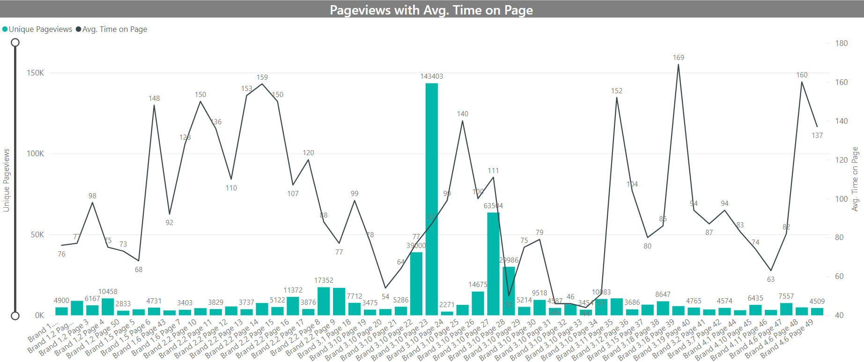
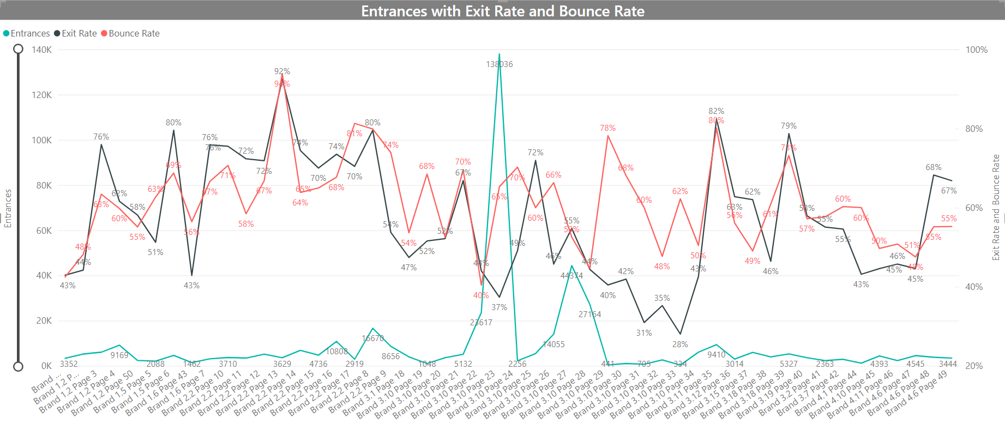
Google Analytics at Brand Level
Brand 3.10 Page 23 has the highest Unique Pageviews (143K), then is the Brand 3.10 Page 27 (63K). And both of them are above average Unique Pageviews (11K).
Brand 3.18 Page 39 has the longest time on page, but its Unique Pageviews, 5.6K is below average(97). Brand 3.10 Page 27 Avg. Time on Page (111) is above average
Brand 3.10 Page 27 is the best page because it’s the only page that 3 KPI performed better than average. Its Entrance (44K) is greater than average (8.8K), Exit Rate (55%), Bounce Rate (53%) are lower than average (57% and 61%).
We’ll provide more insights once we have GA data for business 5.
This graph shows most customers’ first touchpoint is Brand 3.10 Page 23 and 63% of them chose continuing their journeys with next touchpoint. Some of them visited Brand 3.10 Page 27.

Slide 7
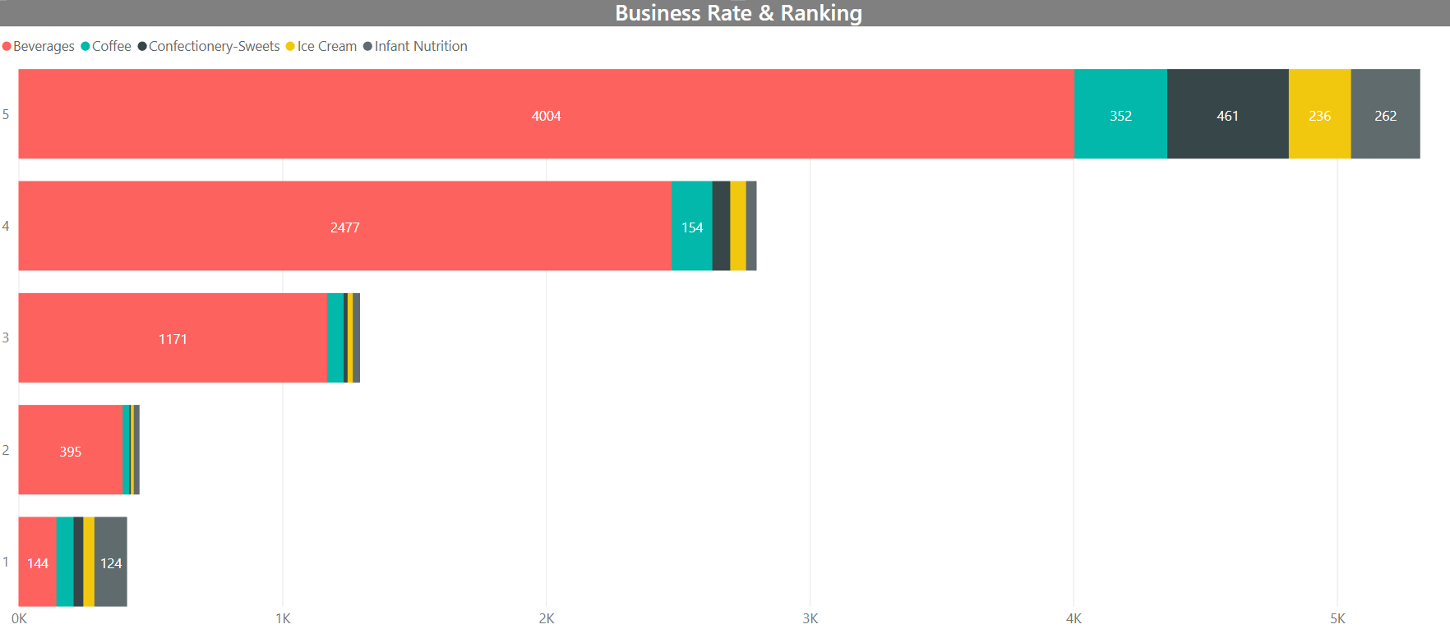
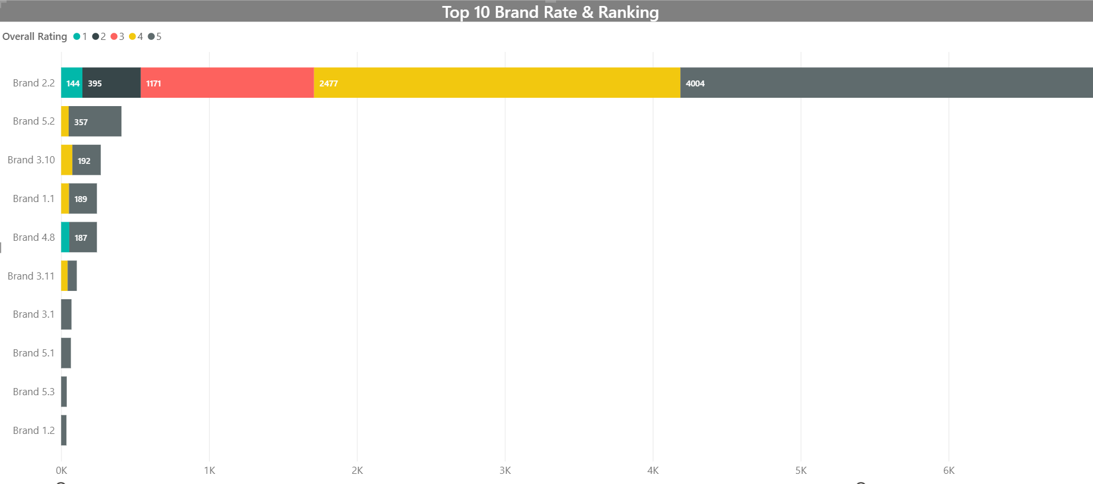
Business/Brand Rate & Ranking
Beverage attracted the most number of reviews (8191), majority (4004) were rating 5 (49%).
Following Beverage, Coffee and Confectionery-Sweets received the 2nd and 3rd most number of reviews.
This bar chart indicates Brand 2.2 received most number of reviews.
From GA in last slide, brand 2.2 page 13 has the highest bounce rate and exit rate, it shows improvement on page 13 could drive brand 2.2 sales further since customers show strong interest this particular brand.
The chart also resonates with GA in last slide that customers show fondness with brand 3.10.

Slide 8
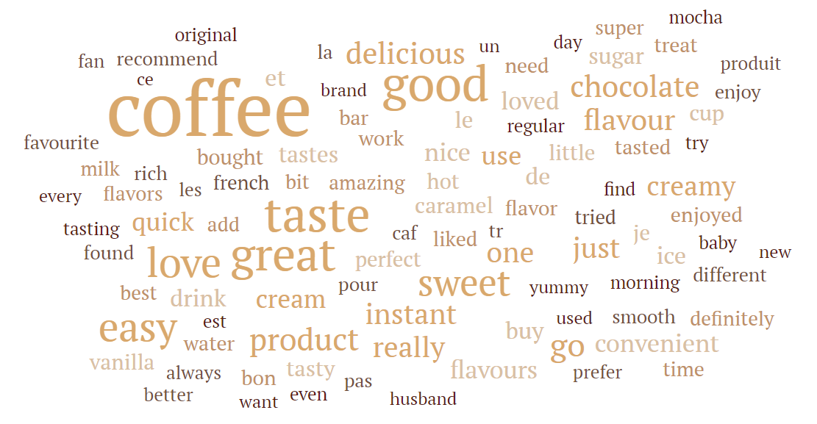
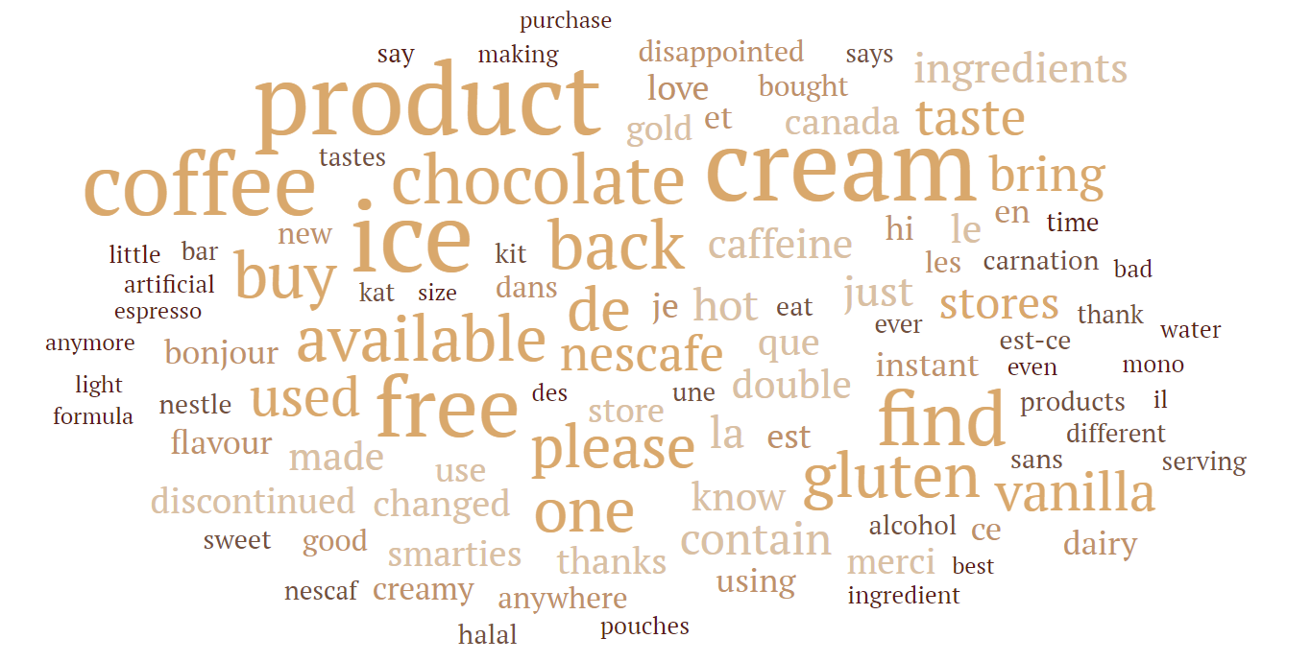
Sentiment Analysis on Q&A
From Rate and Ranking data, most common used words are “Coffee taste great”.
Customers show positive feedback on coffee. They enjoyed its taste and texture and find packages easy to be open.
From Q&A 2020, most popular words in review section are “Product, ice, cream, coffee, free, chocolate”.
Customers comments on Ice Cream that they enjoy brand 4.8’s flavour and they’d like us to continue to sell this brand.

Slide 9
Key Learnings
From tickets in Engagement system, our team propose to conduct sales forecasting at brand level.
If we’re provided with transactional data, we could deep dive into relationships among different business/brands using associated level and generate bundle pricing.
There’s a great potential to boost sale volume for Brand 2.2 by improving Page 13 website to reduce bounce rate and exit rate. Customers have already shown strong interests for this brand.
Consider to resume production on Brand 4.8.
Notes:
Key learnings: has to be related with analytics, not exact actionable items for different departments
Brand 3.10 and Brand 2.2 are the most popular products. Customers aren’t satisfied with Infant Nutrition’s appearance and texture, especially they found ice crystals inside our products. Moreover, they complain Coffee is short weight and Confectionery-Sweets are missing wafer. There’s a great potential to boost sale volume for Brand 2.2 by improving Page 13 website to reduce bounce rate and exit rate. Customers have already shown positive feedback for this product. Continue to sell Brand 4.8.

